Slide 1
Low Level Programming by Example
Considerations, Techniques and Examples for Low Level Programming in C on Small Processors like the ARM Cortex-M Family
Mike Stitt
July 26, 2017

Slide 2
This talk describes the techniques I like when controlling small microprocessors like the ARM Cortex-M.
- With a small example program.
- We’ll walk through the full initialization of the small example program.

Slide 3
“Once upon a time, two programmers walked into a bar and agreed on the best way to program a Kraken.”
Yes – that’s a fable.

Slide 4
Tools I use
OS X
Ubuntu/Parallels
gnu make
make menuconfig – using kconfig-frontends
By Yann E. MORIN http://ymorin.is-a-geek.org/projects/kconfig-frontends
arm-none-eabi-gcc, arm-none-eabi-ld, arm-none-eabi-gdb
All the standard gnu gcc compiler and linker tools, with a “arm-none-eabi-” prefix.
looking at clang
Python, Ruby
Segger jlink
Volt meter
Saleae Logic Pro 16
FTDI serial cables

Slide 5
ARM eabi – what is it?
ARM Embedded Application Binary Interface
https://stackoverflow.com/questions/8060174/what-are-the-purposes-of-the-arm-abi-and-eabi
https://wiki.debian.org/ArmEabiPort
Defines register calling conventions for bare-metal C.

Slide 6
Libraries
Newlib – comes with arm-none-eabi-gcc
Nanopb
lwip – Light Weight IP
Printf2 by Georges Menie and Daniel D. Miller
https://github.com/spindance/printf-stdarg-float/blob/master/source/printf2/printf2.c
Vendor libraries like
STM32F4 DSP and standard peripherals library
STMicroelectronics
http://www.st.com/content/st_com/en/products/embedded-software/mcus-embedded-software/stm32-embedded-software/stm32-standard-peripheral-libraries/stsw-stm32065.html
CMSIS
ARM
https://developer.arm.com/embedded/cmsis

Slide 7
Important embedded c keywords
volatile
An instruction to the compiler, not to the processor to access the memory location as coded.
-It is not and instruction to the processors.
CMSIS
#defines __IO volatile
When reading CMSIS register definitions, a prefix of __IO means volatile
ARM Cortex: __DBM(), __DSB(), __ISB()
Data Memory Barrier, Data Syncrhronization Barrier, Instruction Syncrhonization Barrier
Rarely Needed on the ARM Cortex-M
Instructions to the processor, not the compiler
See http://infocenter.arm.com/help/index.jsp?topic=/com.arm.doc.dui0489c/CIHGHHIE.html

Slide 8
Important embedded c keywords
const
const on the input to blocks of code
is not a contract that the input will not change at some time
Is a contract that the function will not change the input
const on global variables and local static variables places initial values for the variables in ROM
A constant pointer to a volatile register
uint32_t volatile * const registerPtr = (uint32_t *) 0x2000000;
A pointer to a constant and volatile register
uint32_t const volatile * ptr = (uint32_t *) 0x2000000;
I like this description.
http://embeddedgurus.com/barr-code/2012/01/combining-cs-volatile-and-const-keywords/

Slide 9
Thoughts
Low level programming is moving the right bits to the right spots at the right time
Bits start out in flash (rom) and then move to cpu registers, ram, peripherals, to external interfaces (gpios, LEDs, serial, Ethernet).
We’ll walk through how to get the right bits in the right spots.

Slide 10
Useful gcc and make options
Warn about all avoidable and questionable constructions
-Wall
Make all warnings into errors
-Werror
I like -pedantic, but it is too strict for many libraries
Verbose Mode – Print out gcc’s version number and report the final form of the include path
-v
Print the name of each header file used.
-H

Slide 11
Useful gcc and make options
Stop after the preprocessor
-E
Inhibit the generation of line markers in the preprocessor output (useful with –P)
-P
instead of the normal output, generate a list of ‘#define’ directives for all the macros defined during the execution of the preprocessor, including predefined macros. This gives you a way of finding out what is predefined in your version of the preprocessor.
arm-none-eabi-gcc -dM -E - < /dev/null

Slide 12
Useful gcc and make options
Make - quiet down the build so that errors pop-up
Prefix make lines with $(Q)
Options to quiet the build
make Q=@
Options to unquiet the build
make Q=#@
See https://github.com/MikeStitt/lowLevelProgrammingByExample/blob/master/presentations/20170726-meetup-embedded-gr/scaffolding/MakeToolDefs#L86

Slide 13
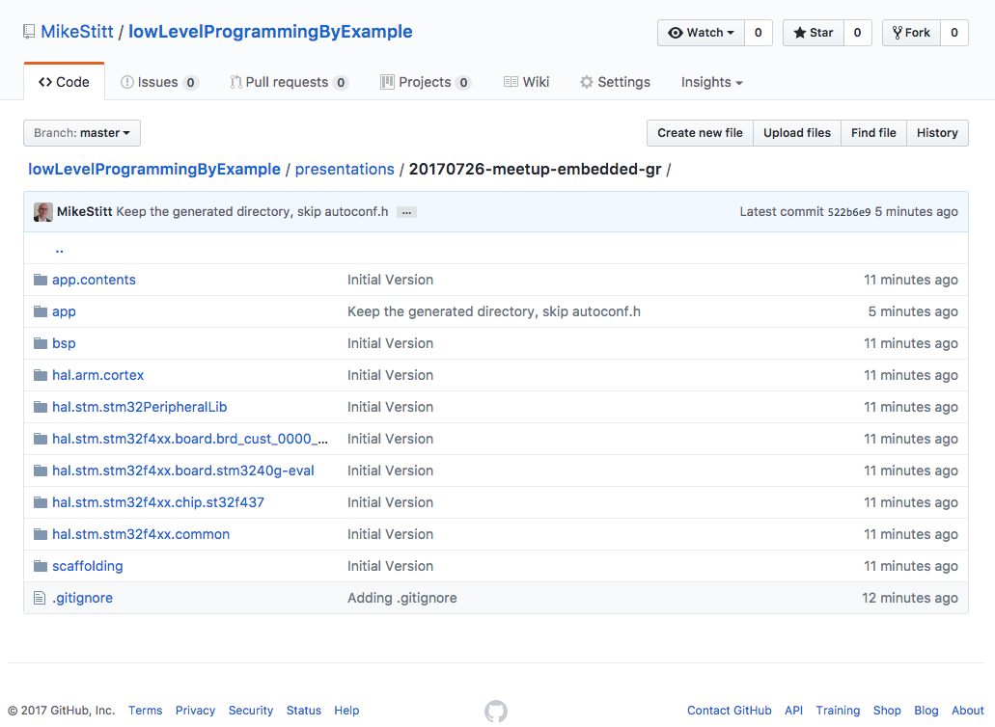
Example source code
https://github.com/MikeStitt/lowLevelProgrammingByExample/tree/master/presentations/20170726-meetup-embedded-gr

Slide 14
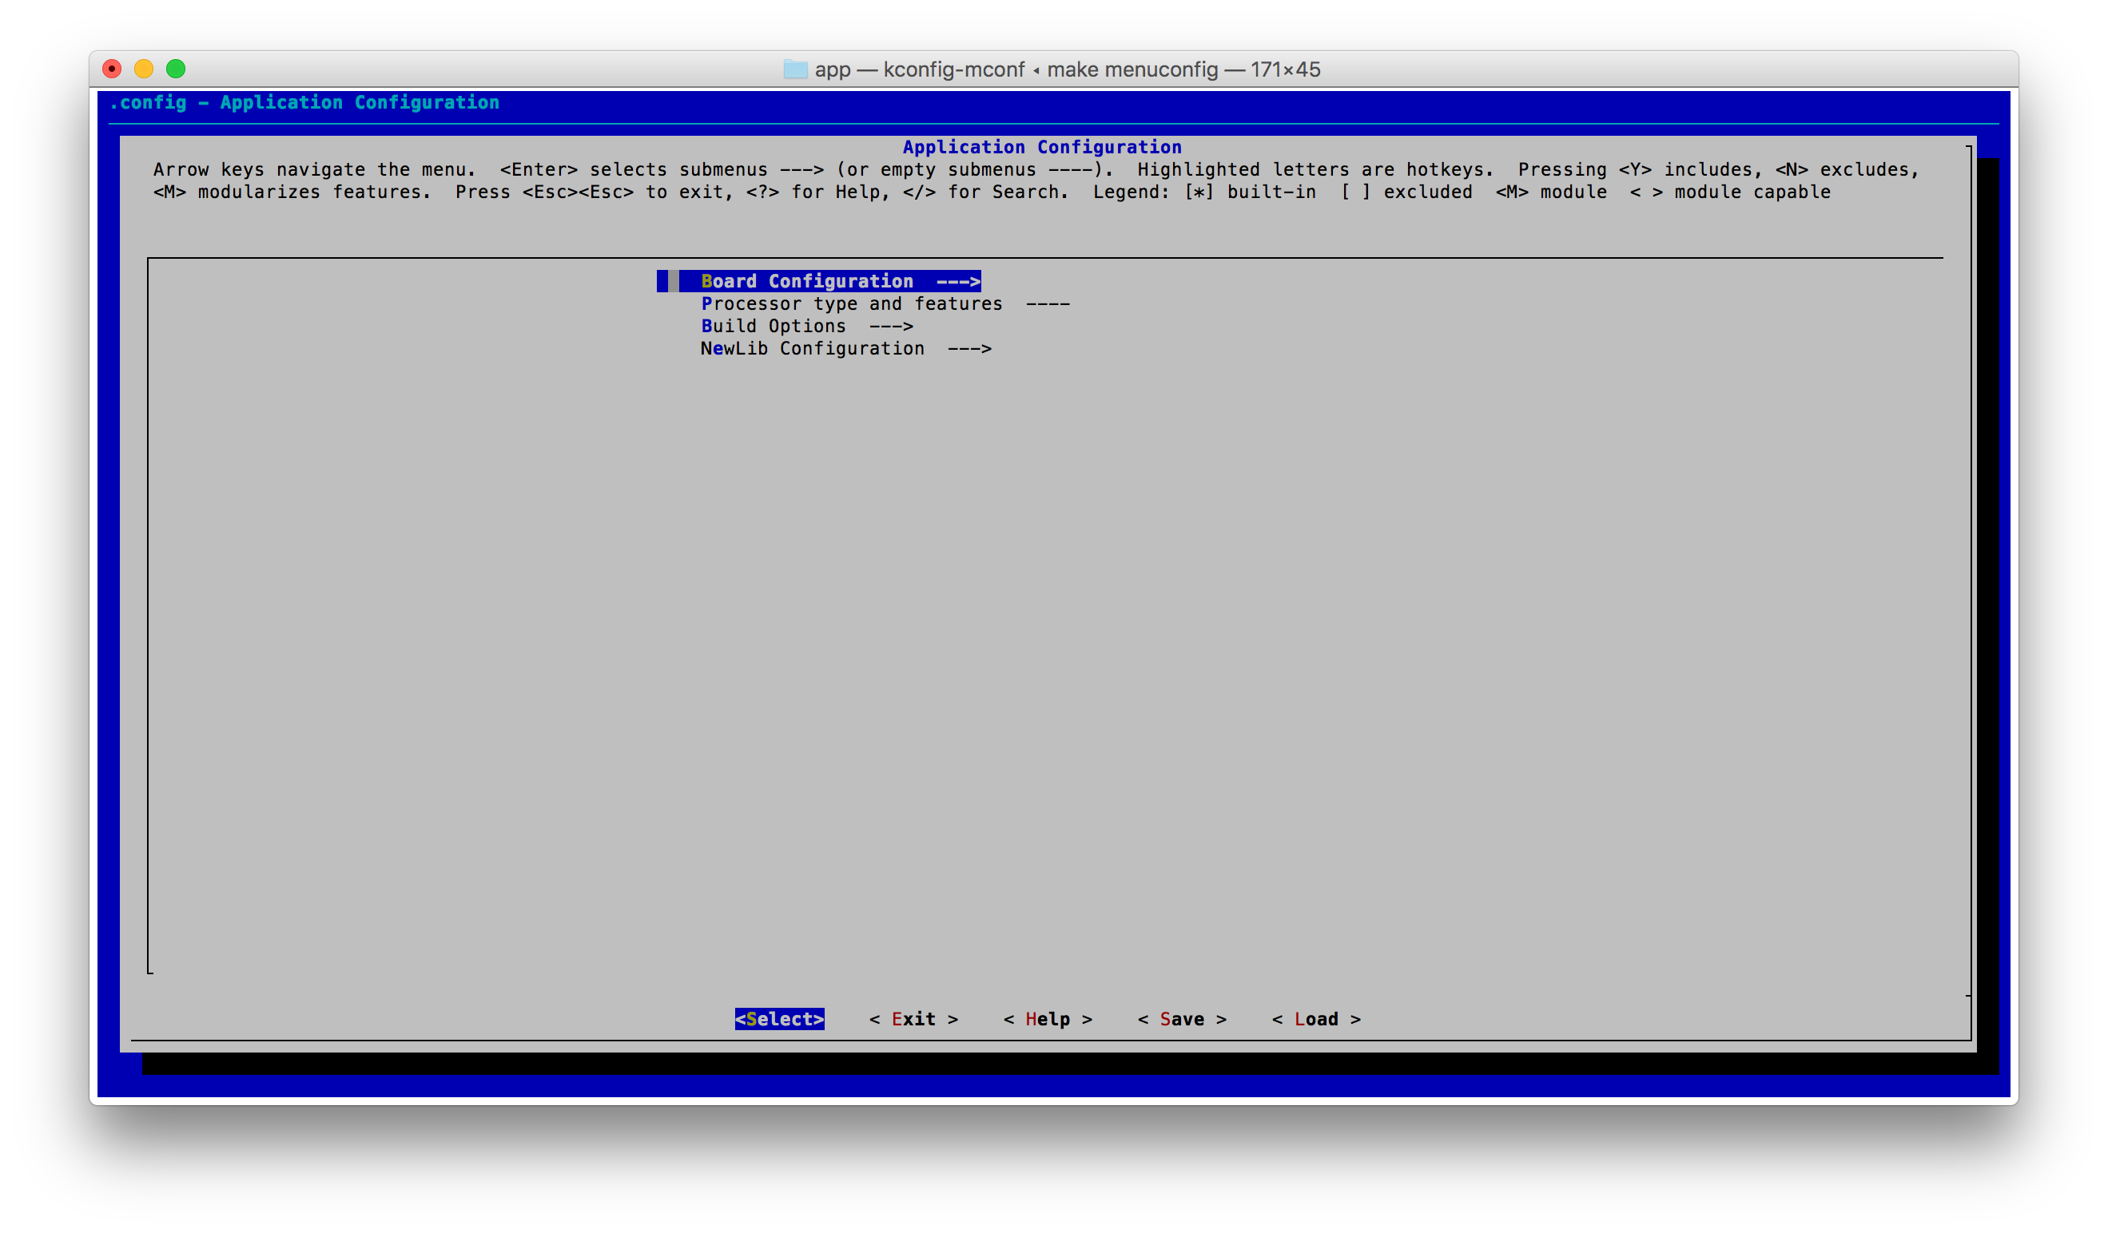
How to build
cd lowLevelProgrammingByExample/presentations/20170726-meetup-embedded-gr
cd app
make menuconfig

Slide 15
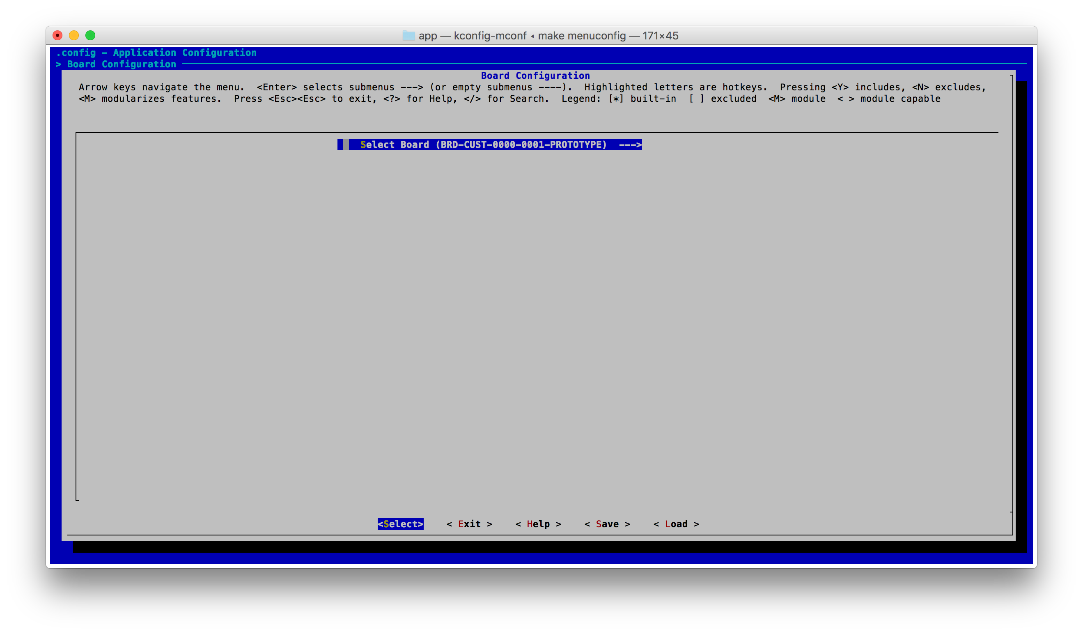
Board configuration

Slide 16
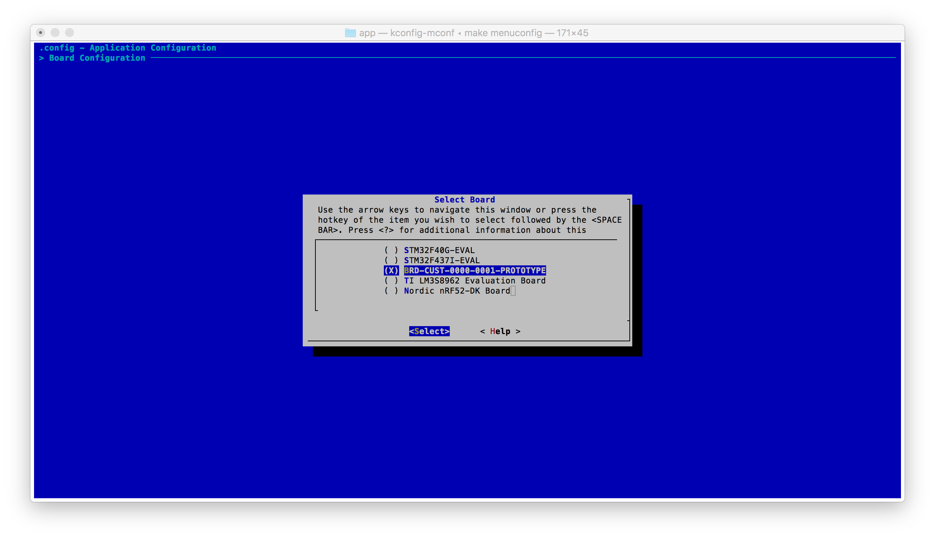
Select the board to be built

Slide 17
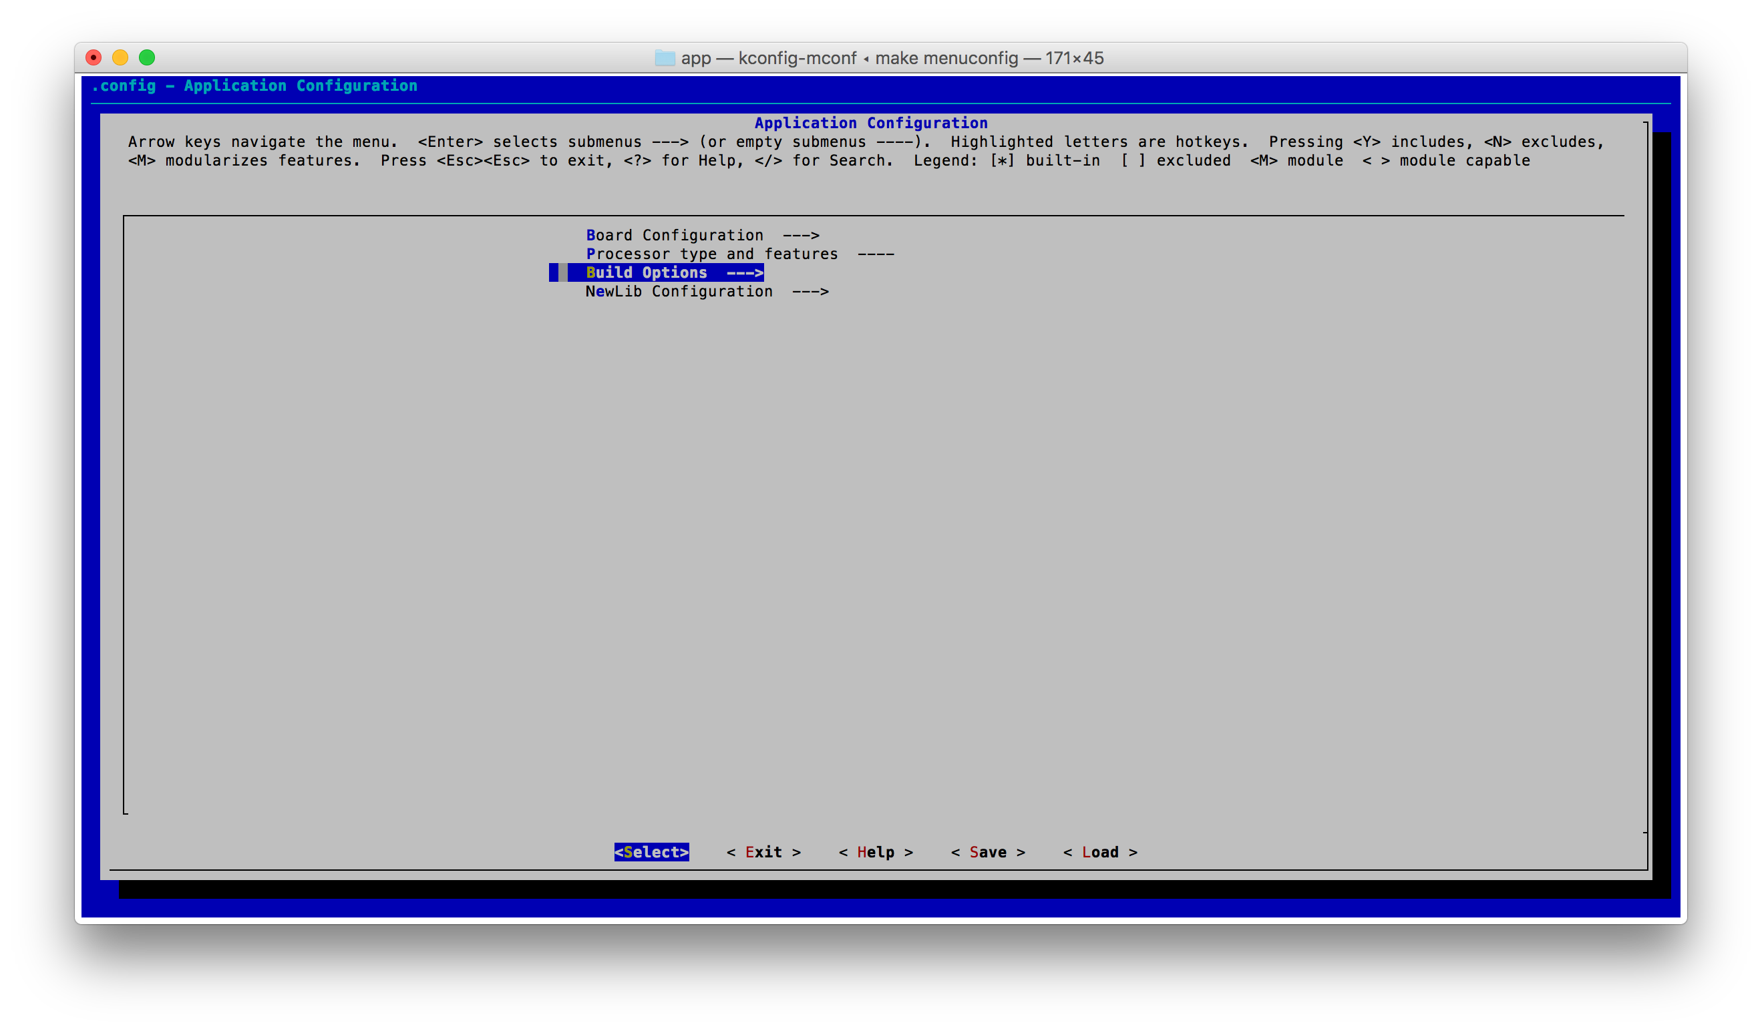
Back up to the main menu, going to build options

Slide 18
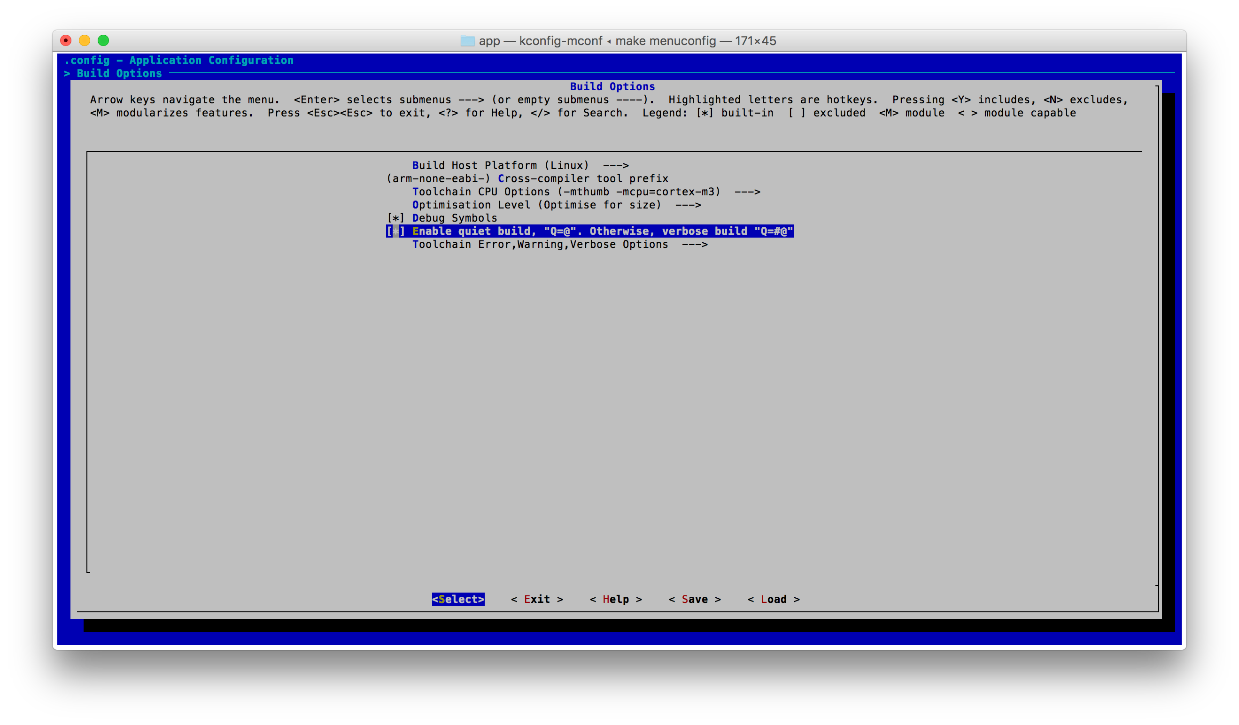
Build Options

Slide 19
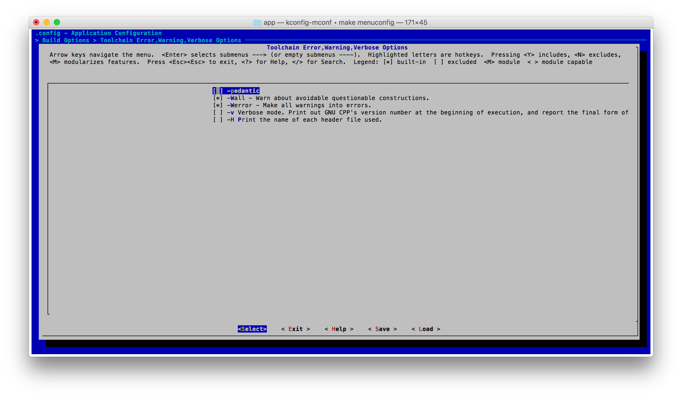
Toolchain Error, Warning, Verbose Options

Slide 20
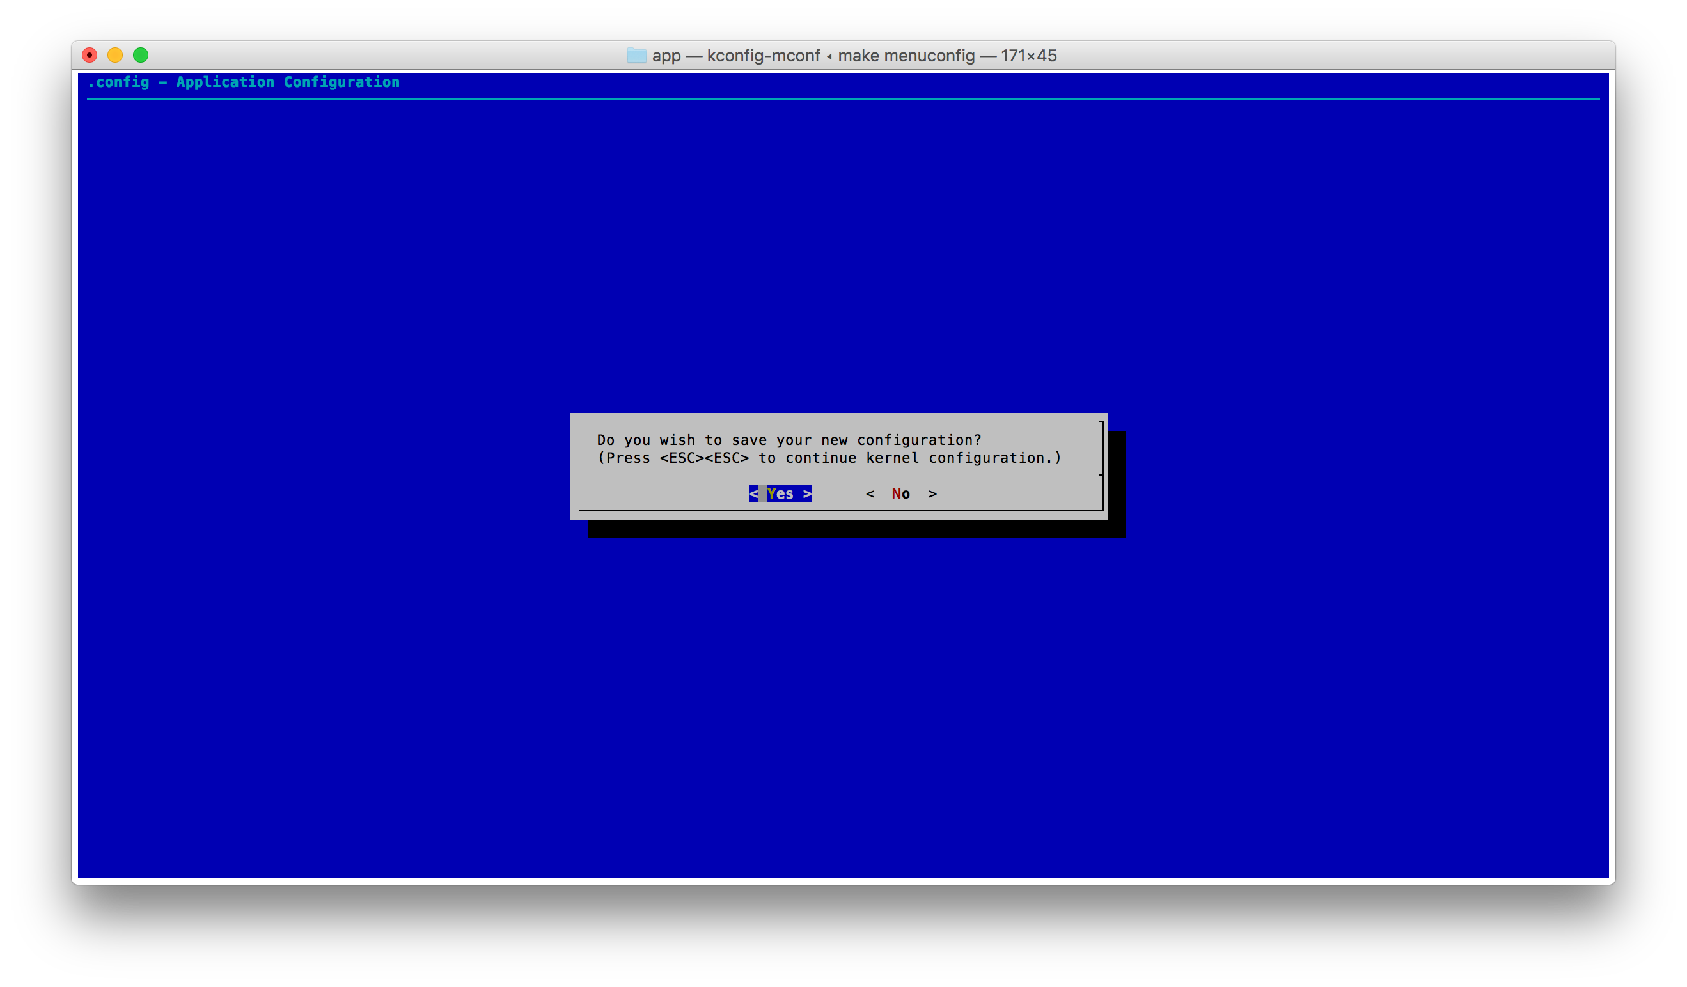
exit, exit, exit … yes to save

Slide 21
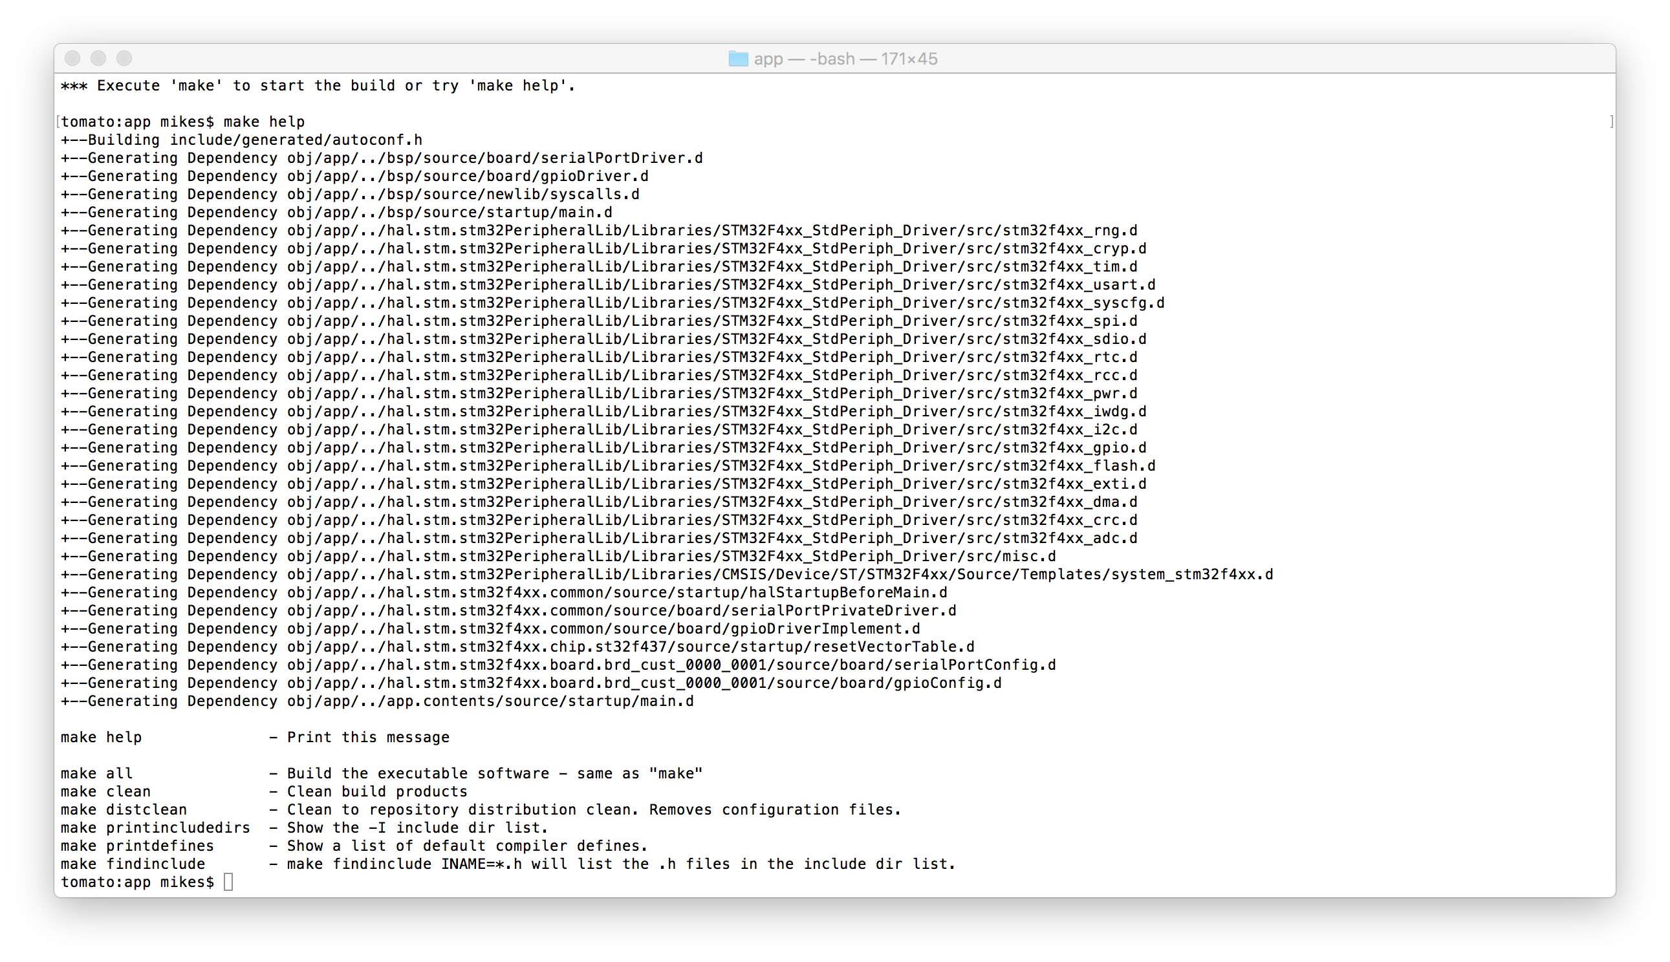
How to build
make help

Slide 22
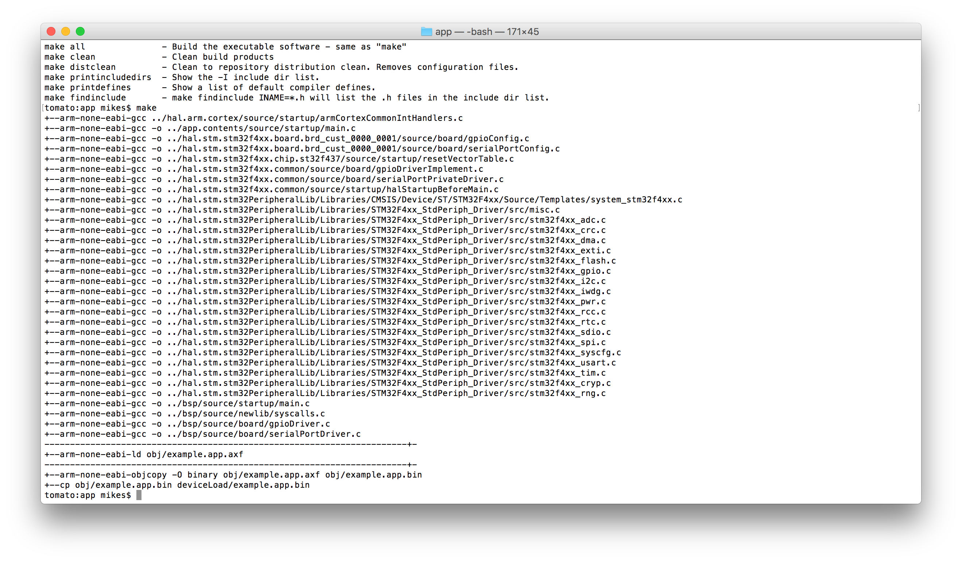
How to build
make

Slide 23
How to build
make
.axf has ROM and Symbols to be loaded by gdb

Slide 24
How to build
make
.bin is the binary image without a load address or symbols. It’s the exact size of the ROM image.

Slide 25
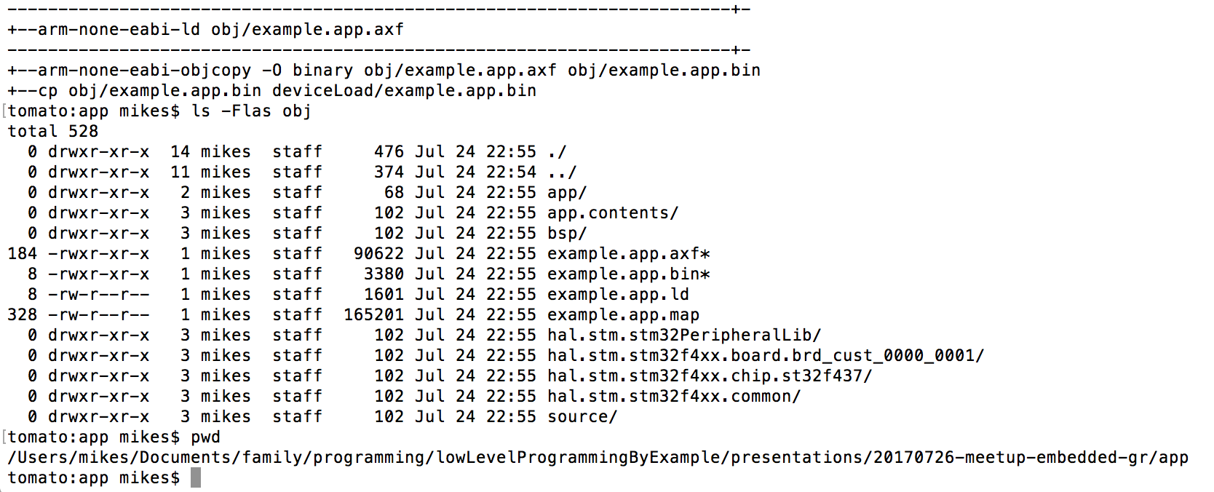
All of the build products go into ./obj

Slide 26
All of the build products go into ./obj
This program is just 3380 bytes.

Slide 27
All of the build products go into ./obj
Debug symbols and load addresses
balloon the debugger load file to
90622 bytes.

Slide 28
We had to tell the linker to put the right bits in the right spots in flash (ROM), and to use the right bits in the right spots in SRAM.

Slide 29
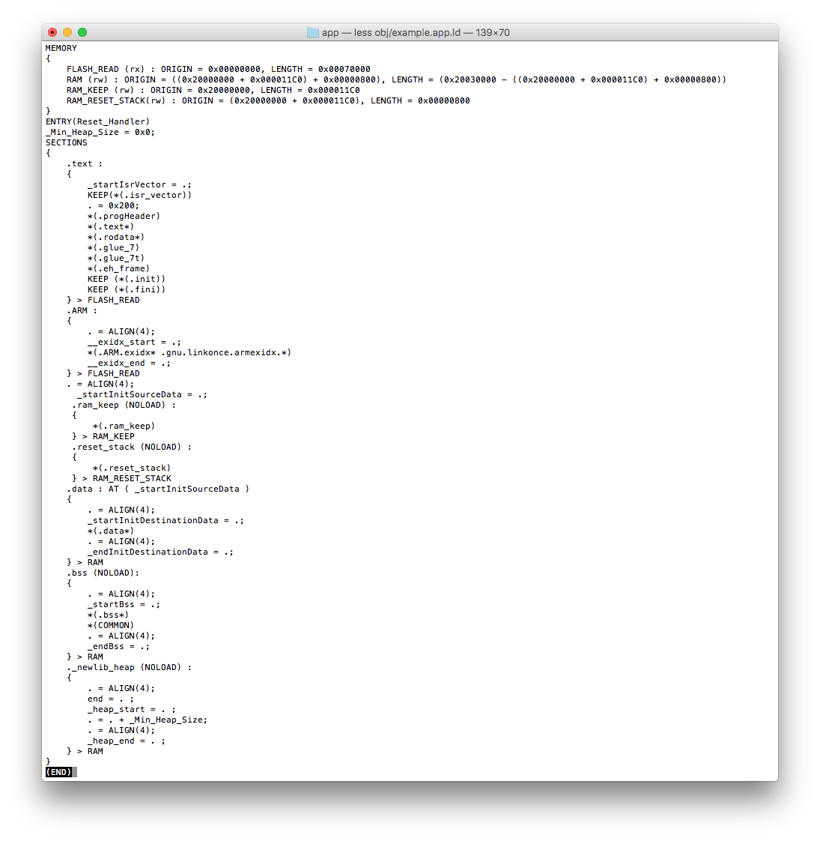
example.app.ld provided instructions to the linker (arm-none-eabi-ld) where to put the bits in the program.

Slide 30
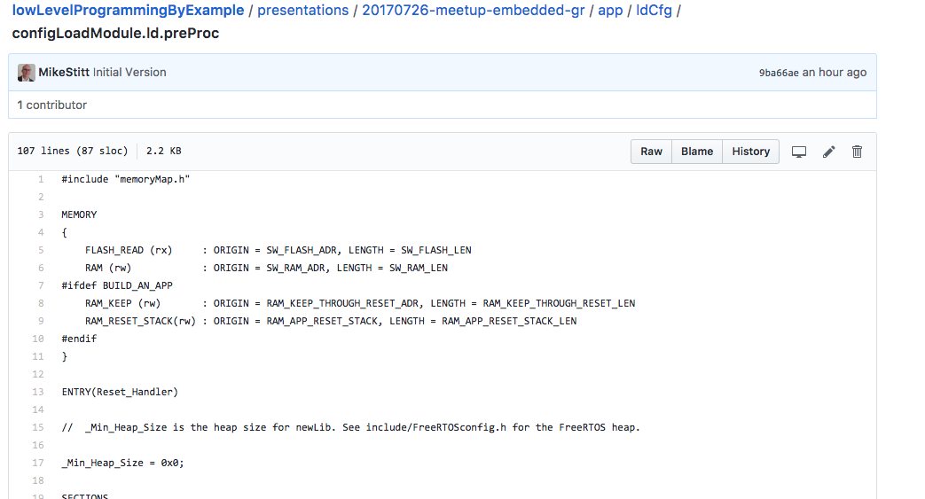
ldCfg/configLoadModule.ld.preProc is configured by memoryMap.h.
This way C code can know about the top level memory configuration.

Slide 31
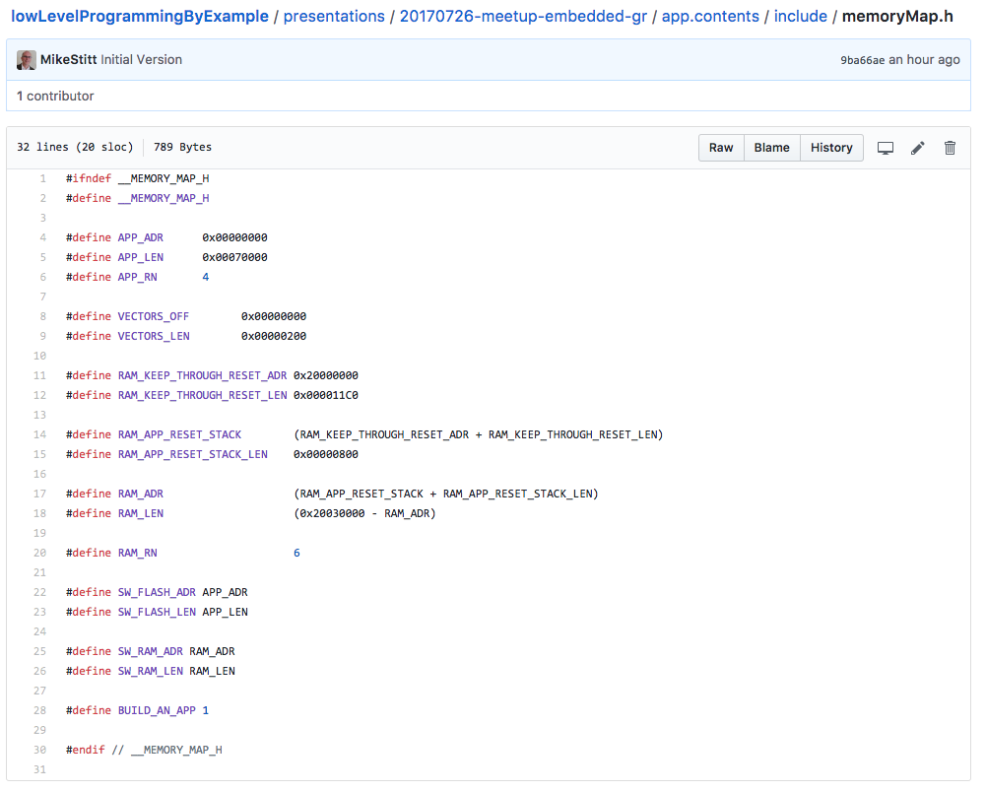
The c preprocessor
does textual substitution to define
the math to place the
top level memory regions of the
processor.

Slide 32
The gnu linkers, ld or in this case arm-none-eabi-ld are able to do simple math to calculate the ORIGIN and LENGTH of the MEMORY regions.

Slide 33
We tell the linker about 4 top level regions of memory that correspond to spots on the chip where the processor can access the type of memory we need. FLASH_READ (rx) – The permanent, sort-of-read-only memory for instructions and constants. RAM (rw) – General purpose read/write memory. RAM_KEEP (rw) – General purpose read/write memory, where we don’t intend to follow the C language initialization rules. RAM_RESET_STACK (rw) – General purpose read/write memory, which we want to use for the processor stack.

Slide 34
We place a ”section” of memory labeled “.reset_stack” at the start of RESET_STACK at address 0x200011C0. We did this because we’re going to use the reset stack for ‘C’ code while we initialize other RAM.

Slide 35
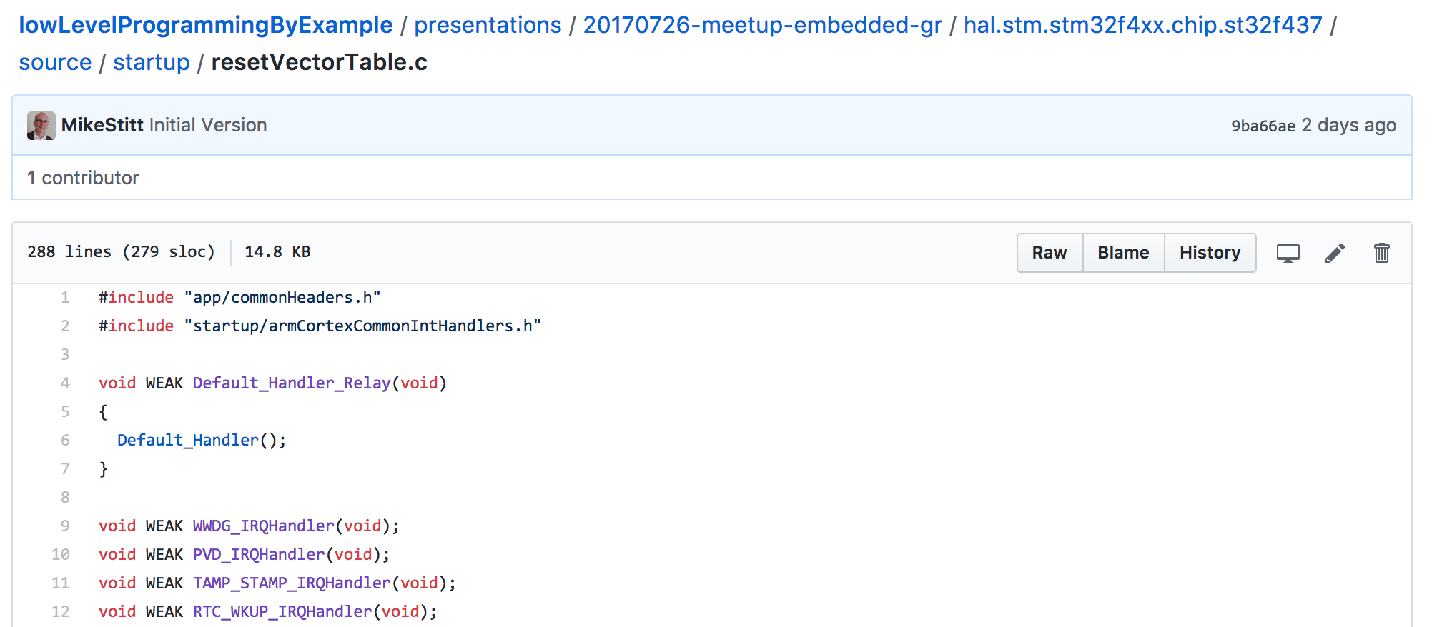
The interrupt vector table is different is slightly different for each ARM Cortex System-On-Chip device. But common interrupts like “reset” are always in the same place.

Slide 36
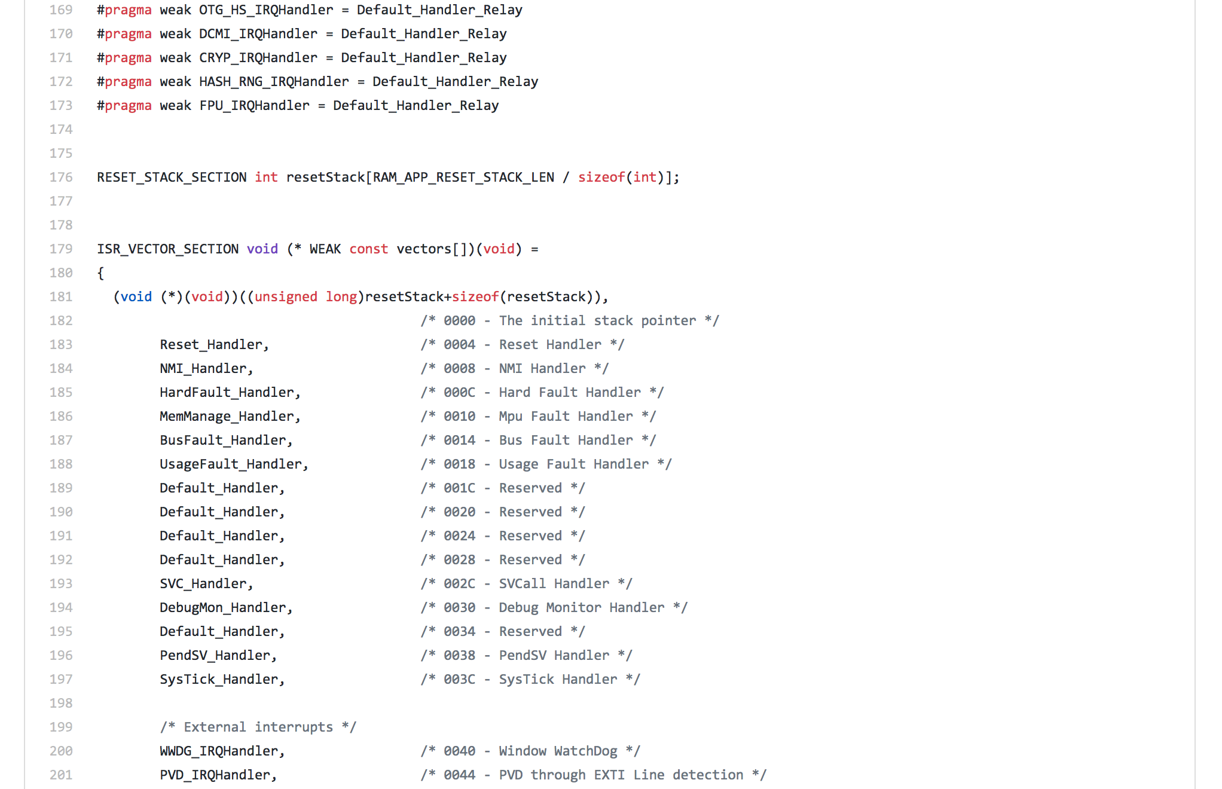
We’re defining the reset stack and interrupt vector table in ”C”!

Slide 37
ISR_VECTOR_SECTION is #define ISR_VECTOR_SECTION __attribute__ ((section(".isr_vector"))) We’ve tied the ”C” code to the linker control file to tell the linker to place this table at address 0.

Slide 38
RESET_STACK_SECTION is #define RESET_STACK_SECTION __attribute__ ((section(".reset_stack"))) Yeah! The linker now knows that resetStack is at 0x200011C0. This is good. We need our stack to be in RAM which is in 0x2000mmmm.

Slide 39
Some fancy math to place a pointer to the the address just past the end resetStack in the first uint32_t in the vectors table. It’s ok. The CPU subtracts 4 prior to writing to the stack.

Slide 40
The second uint32_t in the vectors table is a pointer to the Reset_Handler function.

Slide 41
We have placed a vector table and reset stack at the right addresses in memory.
We’ve loaded the first 2 entries in the vector table with pointers to the stack and the reset handler.
We can release the KRAKEN.

Slide 42
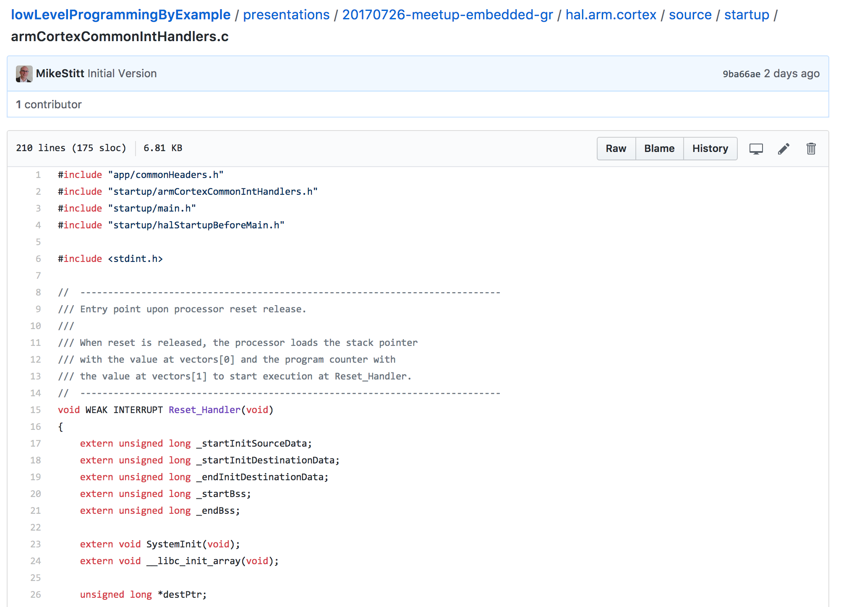
This reset handler can be common to all ARM Cortex-M processors. It’s in “C”. Now days, when interviewing, talking about low level programming in assembly is not the best. Just saying.

Slide 43
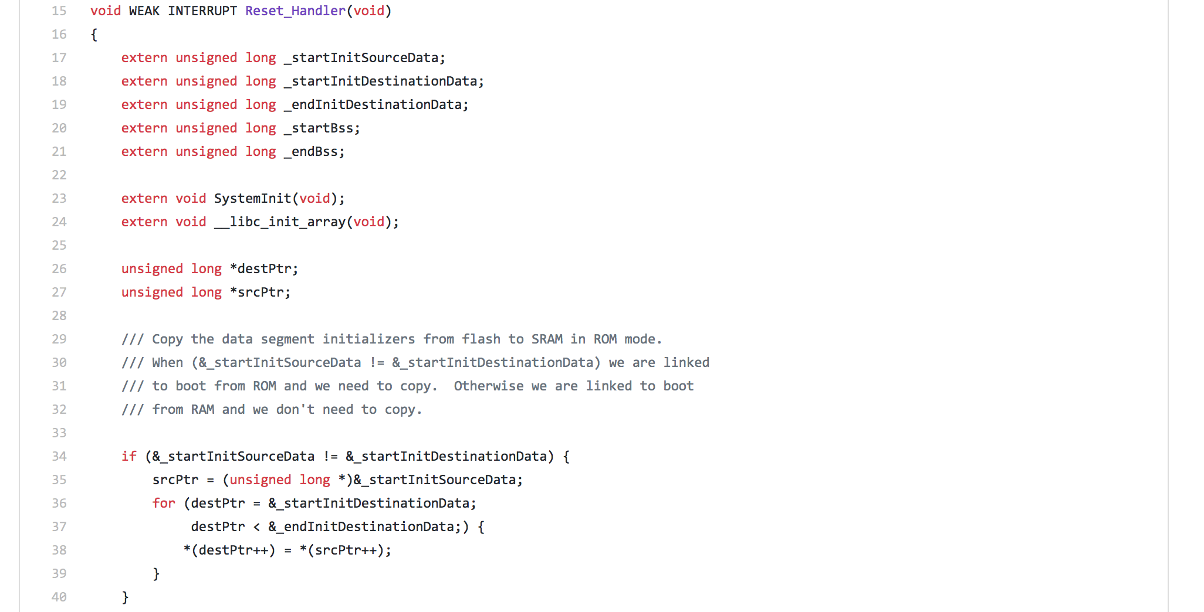
The “C” language allows global variables, global statics, and local statics to take non-zero initial values. Copy the initial values out of Flash (ROM) at addresses defined by the link control and into RAM to addresses controlled by the linker.

Slide 44
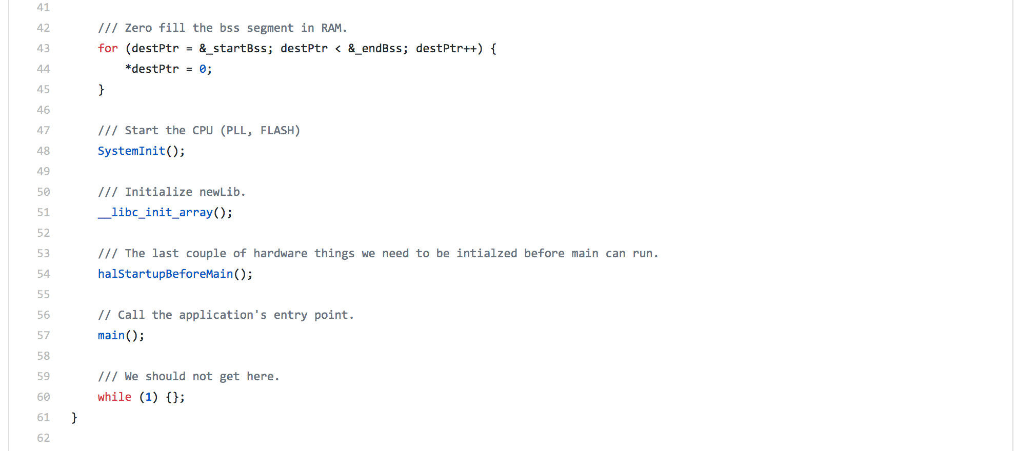
The “C” language requires global variables, global statics, and local statics that are not specifically initialized to default to zero. Historically, the compiler places these in the “.bss” section. To conform (and not be cast out ☺) we zero the “.bss”.

Slide 45
Great News!
C code that uses global and static variables, but doesn’t call libraries, will now work.
The KRAKEN is getting stronger.

Slide 46
Call the vendor specific initialization code to get the processor phase lock loop and clock up to full speed for the chip. Perhaps from a handful of MHz to 188 MHz.

Slide 47
Wait.
We weren’t initializing RAM at full speed?
Nope.
We do it in this order because SystemInit() accesses global variables.

Slide 48
Initialize the newLib “C” library. We can start calling some “C” library functions.

Slide 49
A couple of house keeping hardware initializations that we need to do that are not part of the standard SystemInit()go here.

Slide 50
We’ve made it to main() !!!!
main() should not return, but get stuck here to minimize confusion if it does.

Slide 51
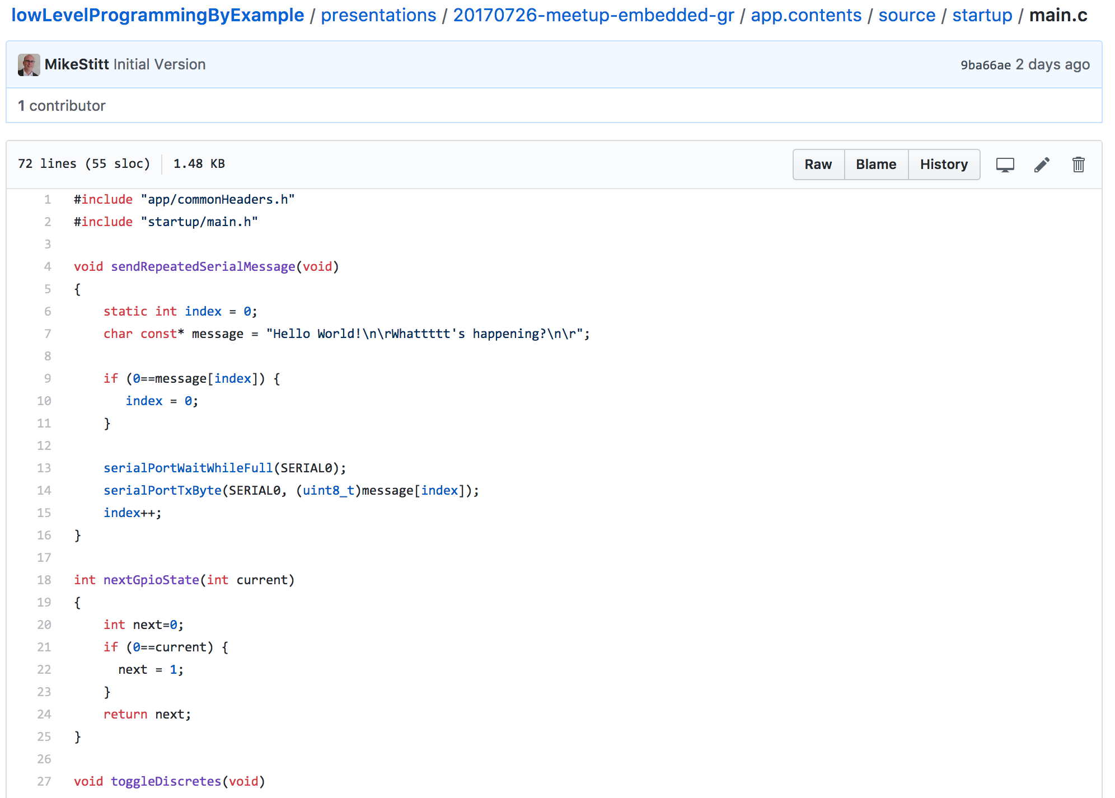
Great news! Our processor is running (Air Quotes) “application” code in main.c .

Slide 52
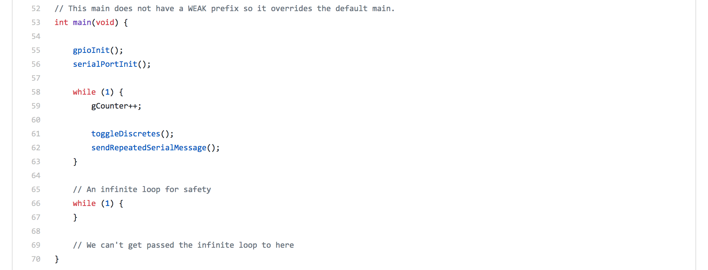
A very simple low level application. It toggles General Purpose IOs (GPIOs) and sends messages out a serial port.

Slide 53
Yes. I’m paranoid. Or experienced. Running a KRAKEN off the end the stack can run your whole day. I tend to drop these loops at the bottom of any function that should never return.

Slide 54
Let’s talk about the GPIO and Serial drivers
and the main infinite loop.

Slide 55
Here’s some handy links to browse the GPIO code:
https://github.com/MikeStitt/lowLevelProgrammingByExample/blob/master/presentations/20170726-meetup-embedded-gr/hal.stm.stm32f4xx.board.brd_cust_0000_0001/source/board/gpioConfig.c
https://github.com/MikeStitt/lowLevelProgrammingByExample/blob/master/presentations/20170726-meetup-embedded-gr/app.contents/source/startup/main.c#L53
https://github.com/MikeStitt/lowLevelProgrammingByExample/blob/master/presentations/20170726-meetup-embedded-gr/bsp/source/board/gpioDriver.c#L1
https://github.com/MikeStitt/lowLevelProgrammingByExample/blob/master/presentations/20170726-meetup-embedded-gr/hal.stm.stm32f4xx.common/source/board/gpioDriverImplement.h#L10
https://github.com/MikeStitt/lowLevelProgrammingByExample/blob/master/presentations/20170726-meetup-embedded-gr/bsp/source/board/gpioDriver.c#L10

Slide 56
Here’s some handy links to browse the Serial code:
https://github.com/MikeStitt/lowLevelProgrammingByExample/blob/master/presentations/20170726-meetup-embedded-gr/hal.stm.stm32f4xx.board.brd_cust_0000_0001/source/board/serialPortConfig.c
https://github.com/MikeStitt/lowLevelProgrammingByExample/blob/master/presentations/20170726-meetup-embedded-gr/bsp/source/board/serialPortDriver.c#L3
https://github.com/MikeStitt/lowLevelProgrammingByExample/blob/master/presentations/20170726-meetup-embedded-gr/bsp/source/board/serialPortDriver.h#L40
https://github.com/MikeStitt/lowLevelProgrammingByExample/blob/master/presentations/20170726-meetup-embedded-gr/hal.stm.stm32f4xx.common/source/board/serialPortPrivateDriver.c

Slide 57
And back to main:
https://github.com/MikeStitt/lowLevelProgrammingByExample/blob/master/presentations/20170726-meetup-embedded-gr/app.contents/source/startup/main.c

Slide 58
Generate mixed c and assembly output
Add
-Wa,-adhln –g
arm-none-eabi-gcc -D"STM32F427_437xx" -D"USE_STDPERIPH_DRIVER" -D GCC_ARM_CM3 -D ALIGN_STRUCT_END=__attribute\(\(aligned\(4\)\)\) -D DEPRECATED -D WDT_ENABLE= -D INCLUDE_AUTOCONF -D ARM_MATH_CM4 -D __FPU_PRESENT=1 -I../app/include -I../app/include/generated
-I../app.contents/source -I../scaffolding/source -I../hal.stm.stm32f4xx.board.brd_cust_0000_0001/source -I../hal.stm.stm32f4xx.chip.st32f437/include -I../hal.stm.stm32f4xx.chip.st32f437/source
-I../hal.arm.cortex/source -I../hal.stm.stm32f4xx.common/include -I../hal.stm.stm32f4xx.common/source
-I../hal.stm.stm32PeripheralLib/Libraries/CMSIS/Include
-I../hal.stm.stm32PeripheralLib/Libraries/CMSIS/Device/ST/STM32F4xx/Include
-I../hal.stm.stm32PeripheralLib/Libraries/STM32F4xx_StdPeriph_Driver/inc
-I../hal.stm.stm32PeripheralLib/Utilities/STM32_EVAL/Common
-I../hal.stm.stm32PeripheralLib/Utilities/STM32_EVAL/STM324x7I_EVAL -I../bsp/source -mthumb
-mcpu=cortex-m3 -std=c99 -mcpu=cortex-m3 -Os -ffunction-sections -fdata-sections -Wall -Werror
-Wa,-adhln -g -c -o obj/app/../app.contents/source/startup/main.o ../app.contents/source/startup/main.c > main.lst

Slide 59
int nextGpioState(int current)
{
int next=0;
if (0==current) {
next = 1;
}
return next;
}
void toggleDiscretes(void)
{
static uint32_t toggleCount = 0;
const uint32_t symbolsPerSecond=115200;
const uint32_t symbolsPerChar = 10;
const uint32_t oneHz = symbolsPerSecond / symbolsPerChar;
const uint32_t fiveHz = (symbolsPerSecond / symbolsPerChar) / 5;
if (0==toggleCount) {
int current = gpioGetOutCmd(GPIOLED1);
int next = nextGpioState(current);
gpioSetOutCmd(GPIOLED1, next);
}
if (0==toggleCount%fiveHz) {
int current = gpioGetOutCmd(GPIOLED2);
int next = nextGpioState(current);
gpioSetOutCmd(GPIOLED2, next);
}
toggleCount = (toggleCount+1) % oneHz;
}
The optimizer is our friend

Slide 60
42:../app.contents/source/startup/main.c **** int current = gpioGetOutCmd(GPIOLED2);
229 .loc 2 42 0
230 002c 0120 movs r0, #1
231 002e FFF7FEFF bl gpioGetOutCmd
232 .LVL15:
233 .LBB34:
234 .LBB35:
21:../app.contents/source/startup/main.c **** if (0==current) {
235 .loc 2 21 0
236 0032 D0F10101 rsbs r1, r0, #1
237 0036 38BF it cc
238 0038 0021 movcc r1, #0
239 .LBE35:
240 .LBE34:
43:../app.contents/source/startup/main.c **** int next = nextGpioState(current);
44:../app.contents/source/startup/main.c **** gpioSetOutCmd(GPIOLED2, next);
241 .loc 2 44 0
242 003a 0120 movs r0, #1
243 .LVL16:
244 003c FFF7FEFF bl gpioSetOutCmd
245 .LVL17:
246 .L19:
247 .LBE33:
45:../app.contents/source/startup/main.c **** }
46:../app.contents/source/startup/main.c ****
47:../app.contents/source/startup/main.c **** toggleCount = (toggleCount+1) % oneHz;
248 .loc 2 47 0
249 0040 2268 ldr r2, [r4]
250 0042 4FF43453 mov r3, #11520
251 0046 0132 adds r2, r2, #1
252 0048 B2FBF3F1 udiv r1, r2, r3
253 004c 03FB1123 mls r3, r3, r1, r2
254 0050 2360 str r3, [r4]
255 0052 38BD pop {r3, r4, r5, pc}
nextGpioState was pulled in to toggleDiscretes()

Slide 61
Thanks!

